Slide 1

Yelp Customer Ratings Prediction
By Group 11:
Madhu Bala Sankaralingam, Melissa Wu, Shariq Lalani

Slide 2
Agenda
1. Contributors
2. Objectives
3. Data collection and preparation process
4. Data exploration & modeling
5. Results & recommended business strategies

Slide 3
Agenda
1. Contributors
2. Objectives
3. Data collection and preparation process
4. Data exploration & modeling
5. Results & recommended business strategies

Slide 4



Group 11: Contributors
Madhu Bala Sankaralingam
Melissa Wu
Shariq Lalani
MCIT UPenn ‘25
Data Scientist Intern at Bapon Ltd
MCIT UPenn ‘25,
Manager at Capital One
MCIT UPenn ‘24

Slide 5
Agenda
1. Contributors
2. Objectives
3. Data collection and preparation process
4. Data exploration & modeling
5. Results & recommended business strategies

Slide 6
Objectives
Our objective is to enhance Customer Experience and Business Performance through Data-Driven Insights for the participating businesses on Yelp
Utilizing the data on customer reviews, customer profiles, and business profiles, we plan to address answer 3 key questions:
1
2
3
Given a business profile and a customer profile, can we estimate the rating that the customer would give to the business?
What are the key features in the business profile/customer profile that influence a customer’s impression of a business?
How can businesses address any identifiable trends in customer rating behaviors?

Slide 7
Agenda
1. Contributors
2. Objectives
3. Data collection and preparation process
4. Data exploration & modeling
5. Results & recommended business strategies

Slide 8
Data collection
The datasets used were made available by Yelp Inc. and represents a subset of Yelp’s businesses, reviews, and user data. The data was provided in three csv files consisting of data on 29527 businesses, 45019 users, and 50000 reviews.
Reviews.csv
Contains full review text data and other attributes such as user_id, business_id, and ratings in stars
Join on busienss_id
Join on user_id
Business.csv
Contains general business data including location, attributes, and categories
User.csv
User data including the user’s friend mapping and all metadata associated such as review count

Slide 9
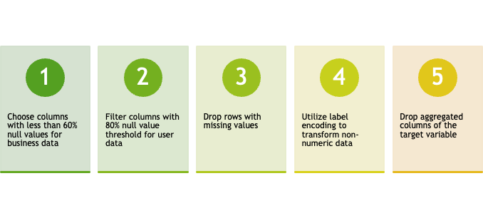
Data Processing Steps
To transform the raw data into a usable format for analysis and modeling, we cleaned the individual datasets using the process below. We then merged the three cleaned datasets into a combined dataframe mapping reviews, business, and user data.
*An additional processing method we tried but ultimately did not make it in final cleaned dataset is imputation. We tried imputating on all categorical (using mode) and numerical columns (using mean) with at least 50% of non-null values and a version where we only performed imputation on the business hours columns. However, these all led to lower performance in all models. We hypothesize that imputation caused artificial clusters that didn’t exist or properly represent the data.

Slide 10
Agenda
1. Contributors
2. Objectives
3. Data collection and preparation process
4. Data exploration & modeling
5. Results & recommended business strategies

Slide 11
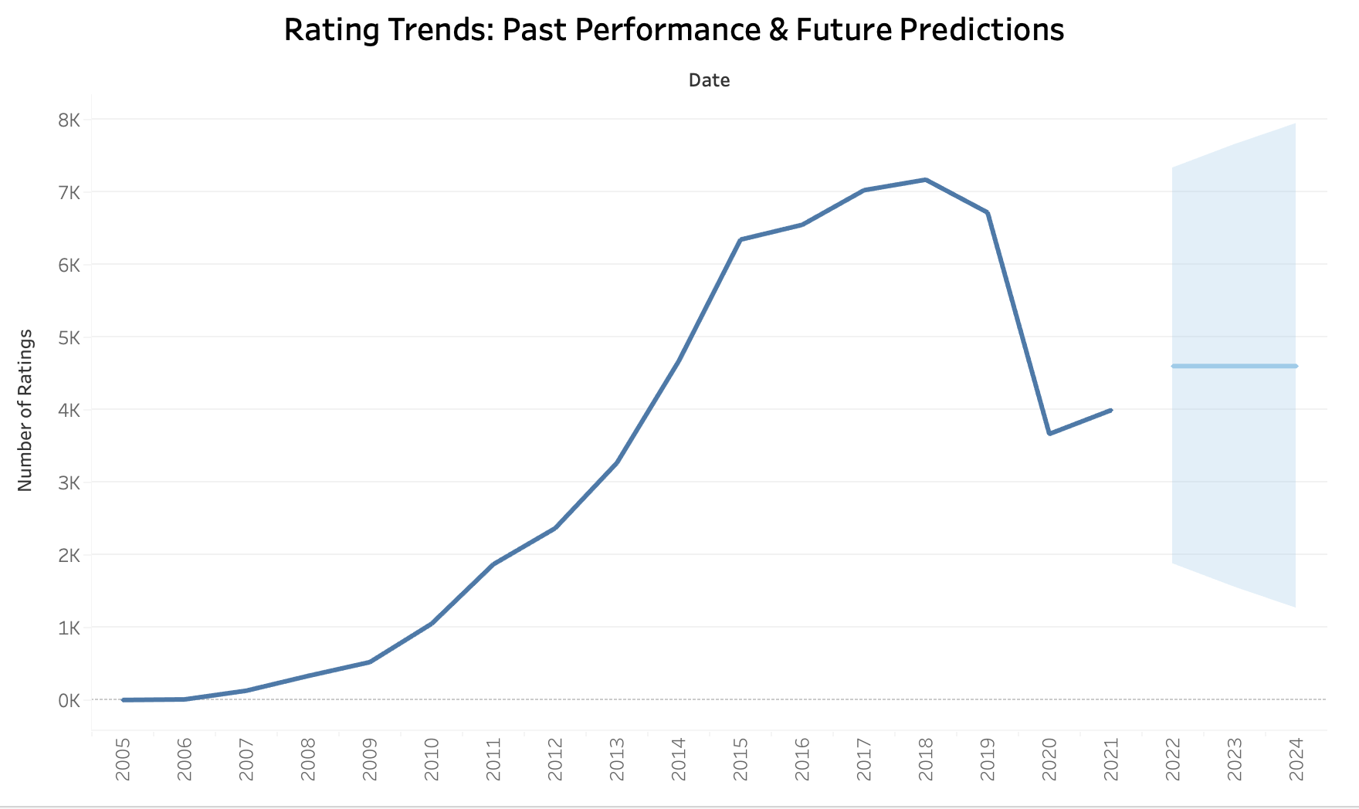
Data Exploration: customer ratings over time
One important consideration is the impact of COVID19 on businesses and ratings. We found that since 2005, overall customer ratings counts across yelp businesses steadily increased up until the COVID19 pandemic hit in 2020. One caveat to note in the analysis is that the pandemic may have influenced changes in the types of business attributes customers consider to be important while making ratings.

Slide 12
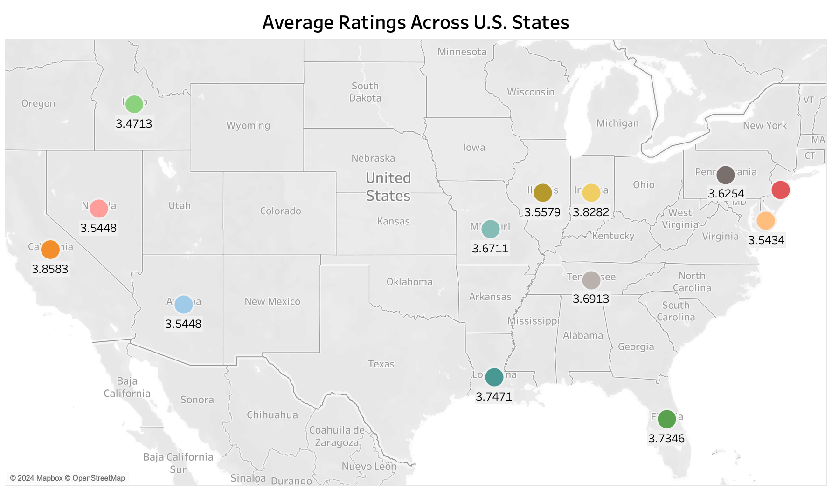
Data Exploration: Ratings across the U.S.
Average customer ratings across states in the U.S. ranged from the highest in California at 3.86 out of 5 to the lowest in Idaho at 3.47 out of 5.

Slide 13
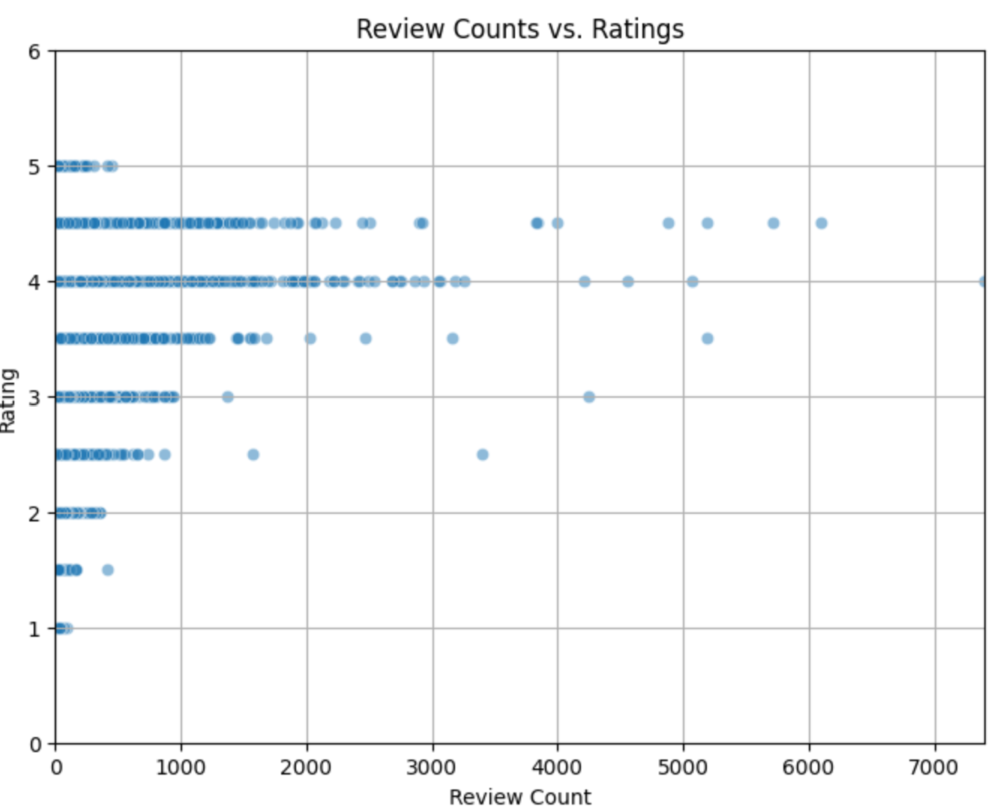
Review Counts Distribution and Ratings
We observed that higher the review counts higher the rating.

Slide 14
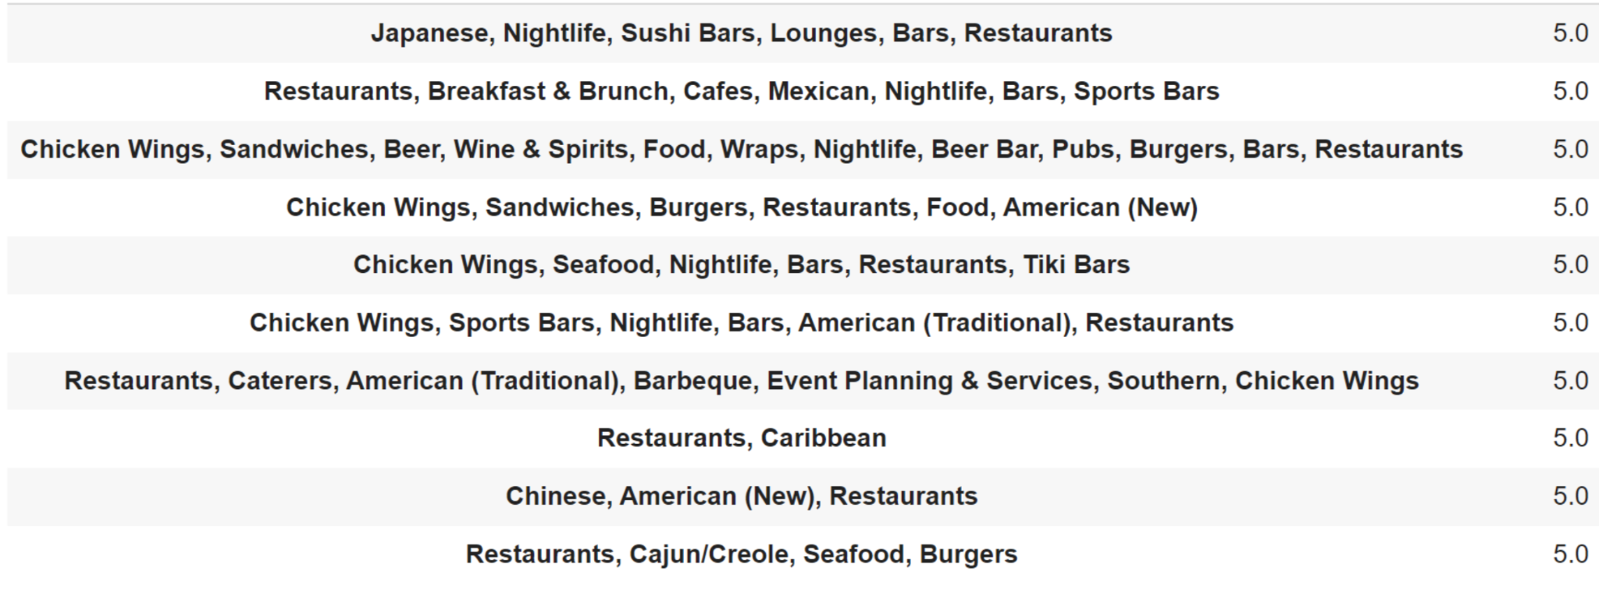
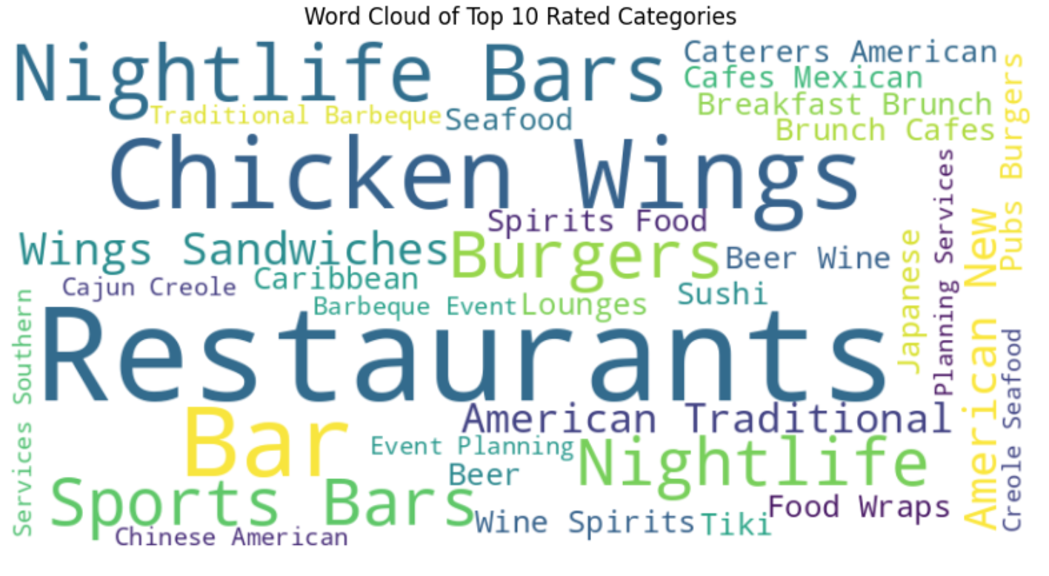
Data Exploration: Ratings by business categories
The businesses with highest customer ratings included key category attributes such as restaurants, chicken wings, and nightlife bars. The top 10 category names are listed below.

Slide 15
Modeling
Once we explored the data, we implemented several modeling techniques to find the best predictor for customer ratings. We found that XGBoost GridSearchCV was the best model based on performance metrics including mse, rmse and r^2.
Model | Reason for use | MSE | Root MSE | R^2
Ridge Regression | Our base model | 1.93 | 1.39 | -
Random Forests with Random Search CV | Evaluates on a random subset of hyper parameter combinations | 1.76 | 1.33 | 0.11
Random Forests with Grid Search CV | Helps identify the best parameters based on performance metrics | 1.76 | 1.32 | 0.11
XGBoost with Random Search CV | Tuned model to test how it behaves with different configurations | 1.73 | 1.31 | 0.12
XGBoost with Grid Search CV | Captures complex patterns in the data while minimizing overfitting | 1.68 | 1.29 | 0.13

Slide 16
Agenda
1. Contributors
2. Objectives
3. Data collection and preparation process
4. Data exploration & modeling
5. Results & recommended business strategies

Slide 17
Key Results: Addressing Business Objectives
Overall, we recommend that Yelp businesses utilize our XGBoost model to design targeted customer marketing strategies by emphasizing key identified business features, such as open hours and wifi availability, in advertisements and using the list of predicted risky customers to design targeted strategies to prevent negative reviews.
Given a business profile and a customer profile, can we estimate the rating that the customer would give to the business?
What are the key features in the business profile/customer profile that influence a customer’s impression of a business?
How can businesses address any identifiable trends in customer rating behaviors?
Yes! Based on our analysis, XGBoost model yields the best predictive outcomes for the Yelp dataset. However, it is important to consider other macrotrends outside of the data which influence predictability, such as the COVID19 pandemic.
Key features identified from XGBoost include:
Business profile:
open hours, restaurant price range, and wifi availability.
Customer profile:
number of overall reviews and the cool reviews
Using the predicted user’s ratings from our XGBoost model, businesses can improve their ratings by using targeted marketing strategies towards each customer group, particularly the risky customers that are predictive to give lower reviews.
Notes:
#3 Identify Risky Customers: Using the predicted user's rating, business can take preventive steps/measures to improve their business rating by creating better users personal experience with that business if a customer's predicted rating for a business is low. They can give out some curated and targeted offers to the at-risk group of customers.
#2 Key features in the business profile/customer profile that influence a customer's impression of a business based on the findings from the best-performing model: ⚛ Cool reviews, Review count, Bike Parking, Open hours(Thursday, Saturday, Sunday, Wednesday, Tuesday and Friday), Restaurants Price Range and WIFI availability.

Slide 18
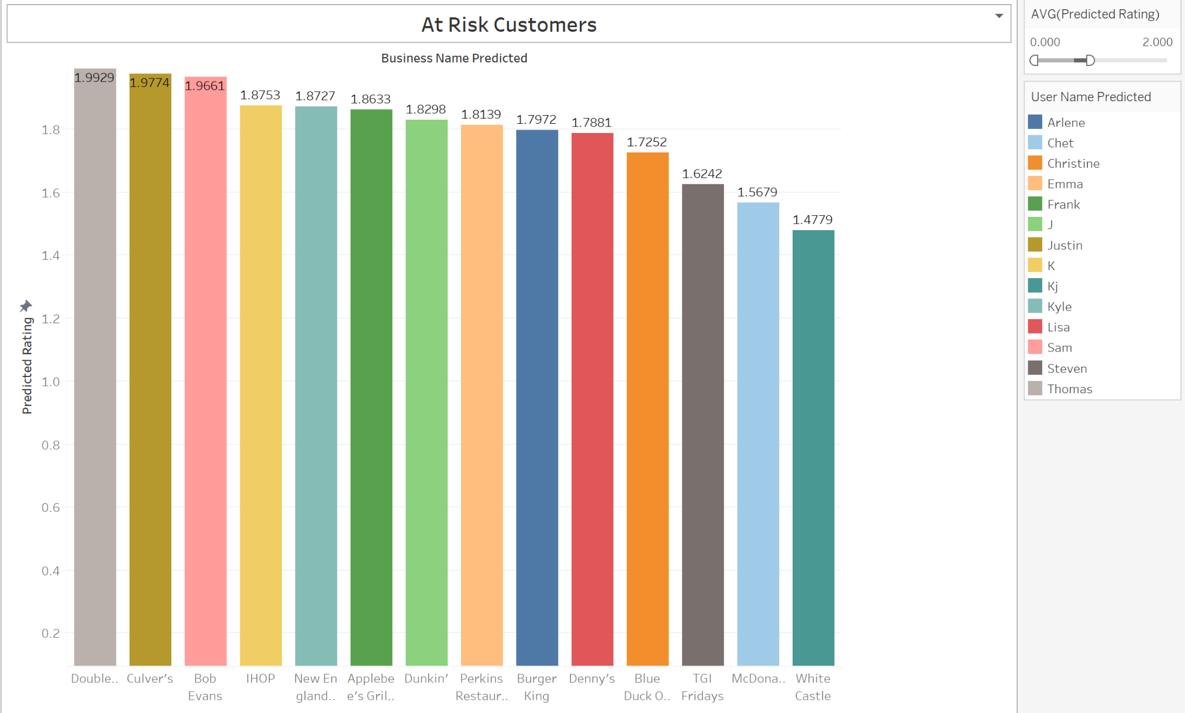
Key Business Strategy Recommendation
For the specific marketing strategy, our main recommendation is for Yelp to use the XGBoost customer rating predictions to help businesses identify at-risk customers and design different consumer refunds / remediation plans for each level of risk. For example, customers predicted to give low ratings, businesses can design specialized customer support steps that go above and beyond typical expectations to reduce the risk that the customer will write a review after a bad experience (e.g. higher $ credit for a next visit).

Slide 19

Additional Business Strategy
Recommendations
Engagement Offers: For businesses with high predicted ratings they can consider initiatives to maintain engagement such as loyalty programs or exclusive offers.
Business Marketing: Using the key influential business features listed, such as open hours and wifi availability, businesses can focus marketing efforts towards highlighting these offerings.
A/B Testing future strategies: We recommend running a series of customer tests to determine the best loyalty and customer support to customers before rolling out one initiative to all customers in each cluster. Customer behavior can be difficult to predict as there are many factors not captured in the data, so rapid A/B testing will help support the success of any strategies implemented.

Slide 20
Thank you!

